Slide 1
DUNE DM paper update
Eric
6-Feb-2020
13-Feb updates in red
19-Feb updates start pg 14
3-Mar until xxx Orange
Notes:
About the Image: A Glass From the Past
While taking a closer look at ancient glass to better understand how it changed over time, Pacific Northwest National Laboratory scientists made an unexpected discovery-the remains of bacteria that once lived on the surface. PNNL researchers and collaborators are delving into the past to further their knowledge about the stability of glass that will be used to safely store low-activity nuclear waste at the Hanford Site. With support from the Department of Energy's Office of Environmental Management, International Programs through the Office of River Protection, they are analyzing this glass found in Swedish hillforts that predates the Vikings because it has a chemical composition similar to what will be produced at Hanford's Waste Treatment and Vitrification Plant and has been "stored" in a known environment for more than 1,500 years.
Research team: David Peeler, Bruce W. Arey, Carolyn I. Pearce, Tamas Varga, Micah D. Miller, Michele Conroy and Michael J. Schweiger (all of PNNL); John S. McCloy (Washington State University); Jamie L. Weaver (National Institute of Standards and Technology); Edward Vicenzi and Thomas Lam (Smithsonian Institution's Museum Conservation Institute); Rolf Sjoblom (Tekedo AB); Eva Hjarthner-Holdar and Erik Ogenhall (Arkeologerna); and Albert A. Kruger (Department of Energy Office of River Protection). The image was colorized by Nathan Johnson (PNNL).
Instrument: Scanning electron microscope and focus ion beam hybrid
https://www.flickr.com/photos/pnnl/24220123368/in/photolist-fqwiqF-aBF44N-fqwj9R-aEuQHd-CUfsRW-pZVLNL-aPjNkZ-fxBosi-aErWsK-aBCnZk-ECMqka-aEr4hT-6yL625-6xvZrp-6xh38v-6xmeiY-VNqjUa-CJUXKp-CPUyAo-25kubq5-BUPMLB-211nysv-Chikdn-Cq6fRm-BscBWe-CnhkRJ-CiHawx-CPUwEu-BUGK7J-CiHawn-BUPKMg-CGEBLY-BUGHTw-CJV1jx-CPUxnw-CSdgpF-CSdj4D-CJUWi6-CPUwFm-BXsubh-CPUxJd-CiHdVB-BUGG5b-BUGHYm-22DixCm-243ex8R-Cq6jHQ-CGEzzy-PEd3HJ-P9S5sd

Slide 2
At last meeting 31-Jan-2020, it was decided/learned:
We still need Richard’s plot on PSD simulation
need refined text (plot?) from Chris about the toy MC conjecture for light collection w dense packed 8x22m^2 and WLS foils on an acrylic border around 6x6x20 m^3 box
I would do the following, after agreeing that an inner 30-50cm polyethylene liner inside cryostat might not be reasonable.
I would run n’s from outside the DUNE-like wood+foam+coldcryoskin wall
We will use Li’s/Beacom’s Figure to show how much water shielding bricks are needed outside
I would run n’s from that coldcryoskin wall too
…there’s nothing in the DUNE DP bulk LAr
Per email from Jose Alfonso Soto Oton
I was seeing “LogicalVolumes” not field cage tubes in the G4 DuneDP drawing

Slide 3
n normalization awareness
In the meantime, I’ve also been running n’s from concrete in DUNE full geom
On the other wp
In so doing, I realize I’ve been normalizing to 10 Hz emanating from rock, not 10 Hz n-capture rate in the LAr, which is the right normalization!
From the full DUNE sim it’s clear to get the 10 Hz capture rate in the LAr, one needs about 20kHz emanating from the rock.
In the full sim that’s what I see
20kHz follows from 6.5 muBq/cm3 in the rock
It also gives a flux from the wall of 0.91E-5/cm^2/sec, as is claimed to be measured at SURF
This is the rate with which to normalize properly
In the following plots you’ll see we need 40 only 20 cm of Li-Beacom water bricks to just get by inside a 10cm acrylic box with O(100) n bkgd even after multiple site cuts at a 100 keV threshold
Sensitivity curves currently show 100 keV with 10 bkgd
Would it kill us to have a 15-20cm thick acrylic box?

Slide 4
I think we need to fix a geometry for the paper.
We this, we can then say how well we’re doing with well-studied geometry and bkgds,
And with further embellishments/tweaks – perhaps not precisely specified – we can get to an O(1) bkgd at 75 keV and O(10) bkgd at 50 keV ….
Basically more plastic everywhere.
So, for that geometry, I propose that we say we have the 40 20 cm water bricks among the I-beams, along with the wood-foam-coldcryoskin wall, and a 10+cm acrylic box inside
This is all consistent with what I’ve modeled
Except not considering the neutrons from the I-beams themselves
Alternatively 50cm water, 10cm acrylic
New, tall inner acrylic box.

Slide 5
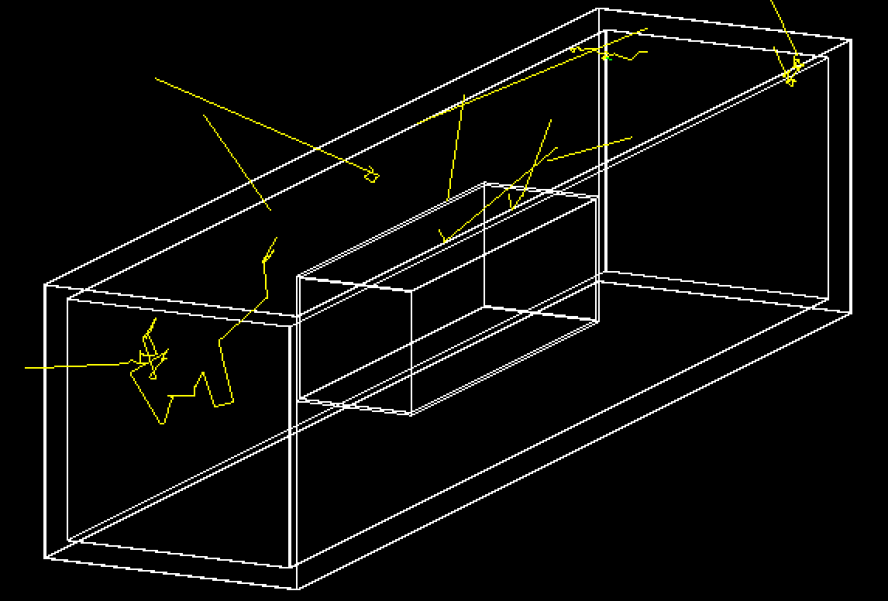
Geometry G4 pic
10 neutrons launched per the rock spectrum (next pg) from top outside the ~80cm foam+wood+cold-cryoskin sandwich.
Inside is the 10cm acrylic box surrounding our fiducial 1 kt on the walls of which one imagines WLS foils
See next page

Slide 6
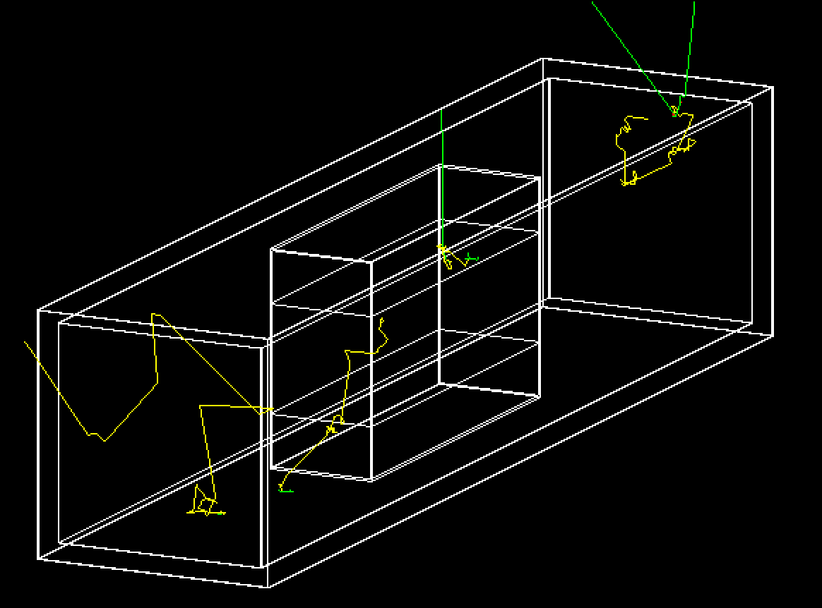
13-Feb-2019: new tall box.
Neutrons now emanated uniformly from the inner surrounding6-sided coldCryoSkin, not from a plane, and multiplied by (4+2*r).

Slide 7
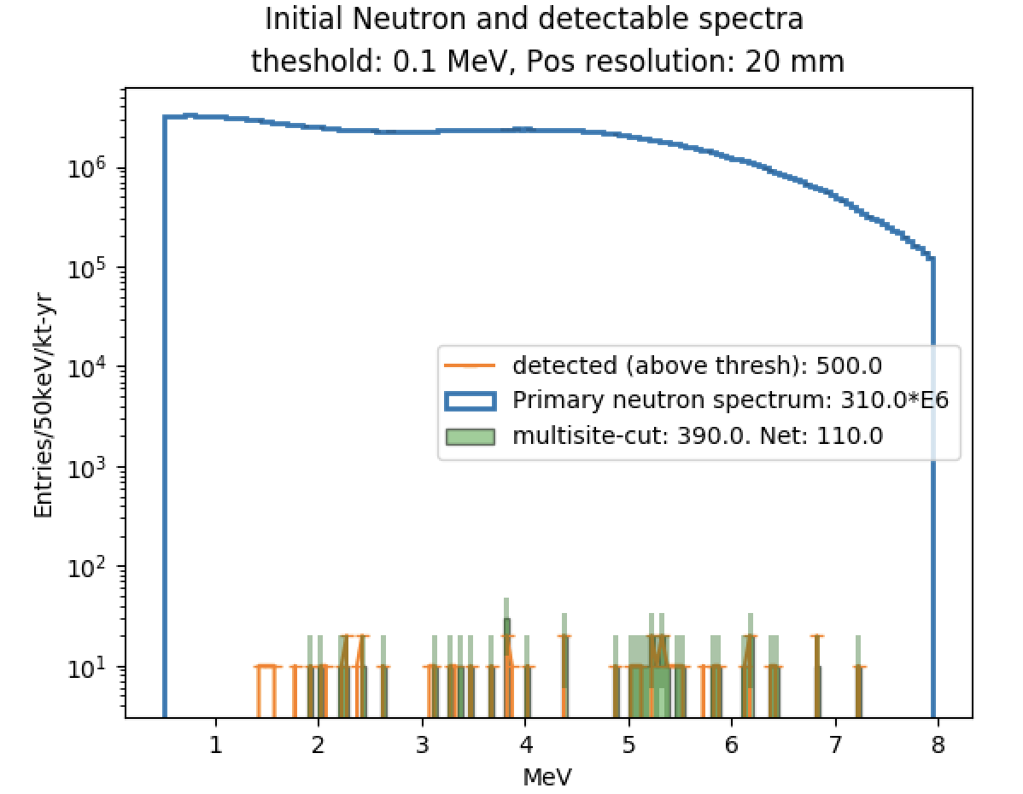
n flux in our 1kt from outside rock in LAr

Slide 8
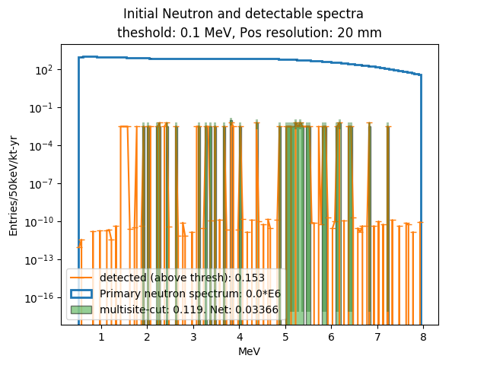
13-Feb-2019 update to previous using 0.9E-5 /cm2/sec n emanation from walls.

Slide 9
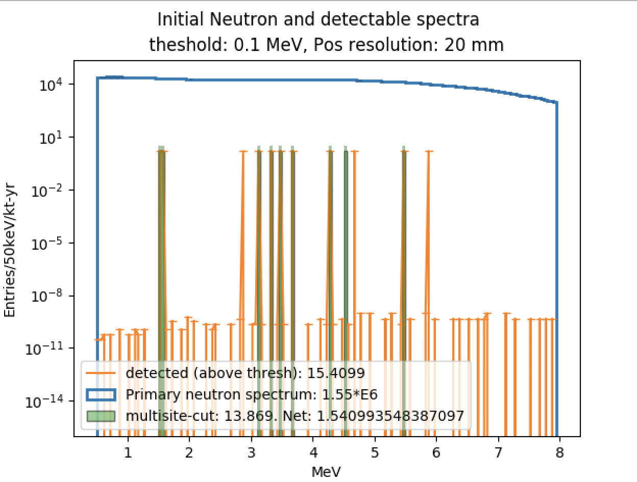
n flux in our 1kt for U+Th coldcryoskin
Per Richard, from https://www.sciencedirect.com/science/article/pii/S0168900208009984:
“The neutron yields for 1 ppb of U and 1 ppb of Th are 1.47E-10 n/s/cm3 and 4.74E-11 n/s/cm3”
Not really sure I understand this low-level grass of very low-weighted events….
But you can see 12 evts pass the cut, 9 of which are tagged as multi-site
I used same n spectrum as for rock neutrons.
Chris says it should be 269+/-169 U238 and 19.7 Th232 ppb.
So 457E-10 n/cm3/sec
I used
20E-10 n/cm3/sec
23x too low
So 35 n’s/year

Slide 10
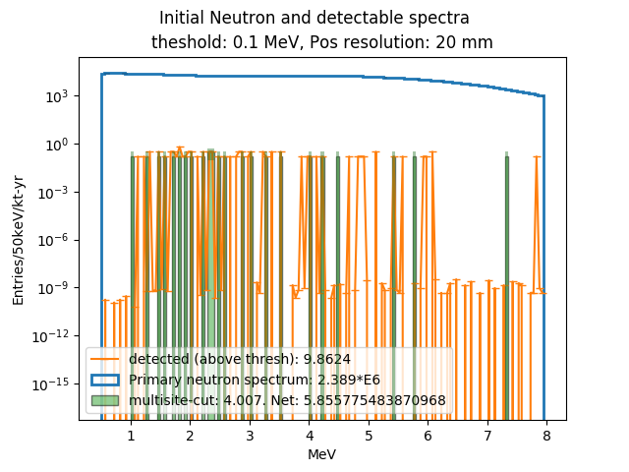
13-Feb 20cm thick Acrylic
This 5.8 makes some sense. I used 20E-10 n/cm3/sec, and cryoskin is 1cm thick. So This is 2E-9 /cm2/sec, very comparable to the neutron flux coming from walls, but here we don’t have benefit of 20cm water. Which would give a x100 reduction, ~0.05 which is quite close to what I got for neutrons from rock. (Presuming our acrylic is not helping much.)

Slide 11
Darkside 20k paper
https://arxiv.org/pdf/1707.08145.pdf
Lots of Rn scenarios carefully considered
Clearly we must say something about this, even if we don’t simulate anything

Slide 12
Notes from 6-Feb meeting itself
Acrylic box must be a tall box with top/bottom inside ss cryoskin but outside light detection.
So as not to interfere with E field and charge drift
This means in G4 my symmetry is lost that has allowed for launching ns just from ceiling.
I need to try to put in this acrylic box and launch n’s from the coldcryoskin Volume. This can be a G4 nightmare … I will give it half a day and try. This is now done.
Also it is thought DEAP’s acrylic is 5cm, so already hard to argue we should go thicker, though
I should launch n’s from some cryoskin as I have it for a thinner and a thicker acrylic, just to see the effect: 5cm, 15cm, 20 cm. Done for low, hi, hi stats, resp
We will declare we need 3-10x cleaner ss and this 10cm of acrylic, most likely
And, from Beacom, we need 60 20 cm of Water to get the outside n’s reduced another 2 orders of mag

Slide 13
13-Feb mtg notes
Chris shows needed SiPM packing floor and/or ceiling to get nph/100keV threshold. Presuming wls foils on acrylic walls, ….
Will perhaps add some PMT lines to this plot
Will explain his toy MC in text,
Will have a stab at a better n/gamma bkgd table than is currently in
Eric: Acrylic should lose the roof and floor. Should also be bumped out a meter in all directions.
Also, try to go back to DEEP’s 5cm thick Acrylic, since it is not buying us too much.
Do boe calc for n’s arriving inside fv. Done, sorta.
Will address the text, currently full of all kinds of geometry mishmash description
Richard will get Gabe to do a solid works design that looks something like the TDR image of DUNE DP, with tiled SiPMs floor and roof. Hopefully, cryoskin + wood + foam.
Will add F90 plot. Might also run a longer sim.

Slide 14
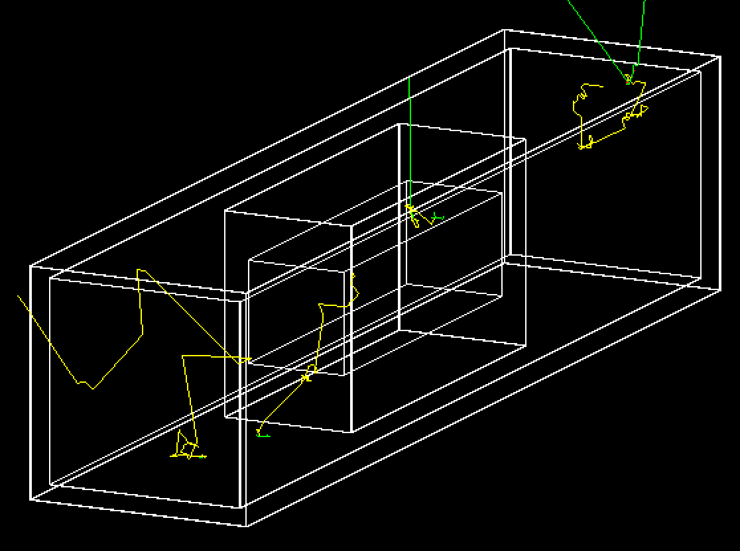
13-Feb post-mtg

Slide 15
Meeting, 19-Feb-2019
Acrylic is now 5cm thick, ala DEEP, not 10cm
Acrylic box as no ceiling/floor
Bumped out 1m on all sides: 8x12x22 m3 box
Fixed bug in over-subtracting one or two events in which a n gamma capture happened w no n.r. in fidvolume
Made plots to clip off rounding error 0 entries, fix over-subtraction bug
cold cryoSkin n count went up a little in fid volume: ~ 7.8 evts after multisite tag
0.53 evts from rock muons
Made xy,yz,xz n plots – point of n emanation in cryo skin (next)
Now, use to reweigh cryoskin and give contribution from SiPMs/camera
Made all my text changes to Overleaf paper. Still some obvi things needing doing, wrt text, beautifying plot, omitting one plot, table fix, text, refs
I note there is ~ 2.5 k$ left on our wp.

Slide 16
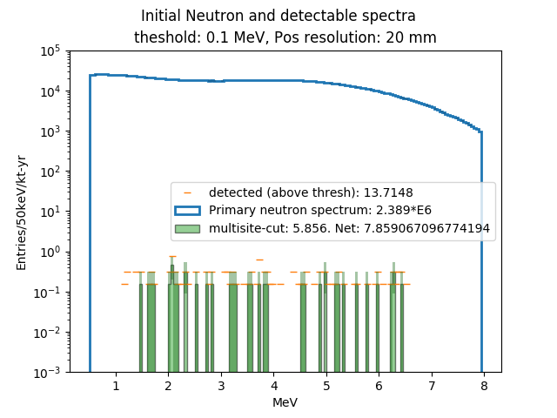
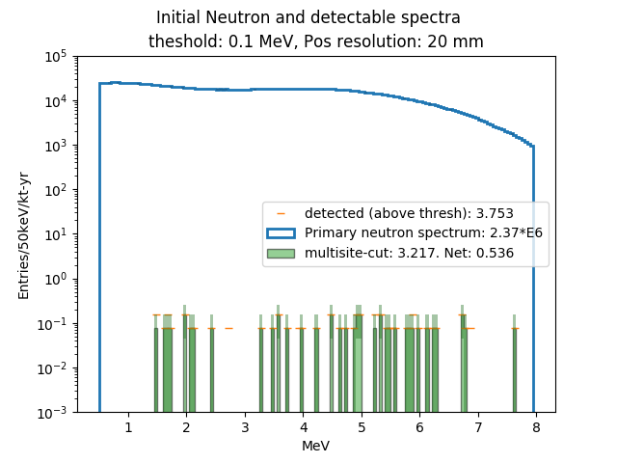
Cryoskin (left), Rock (right)

Slide 17
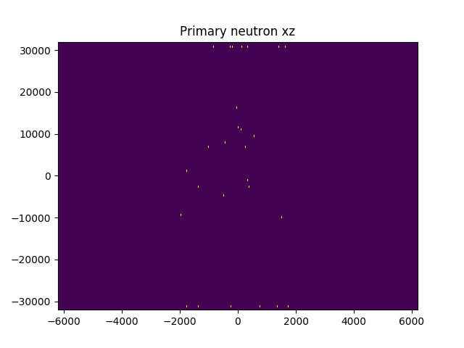
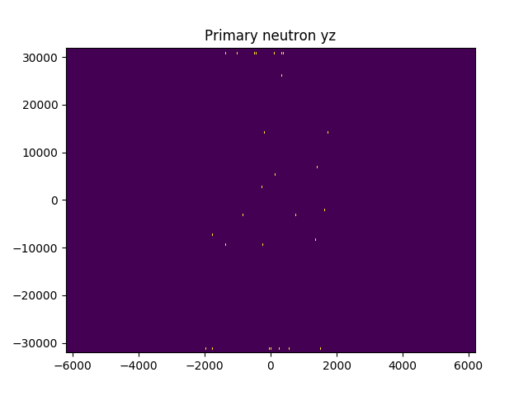
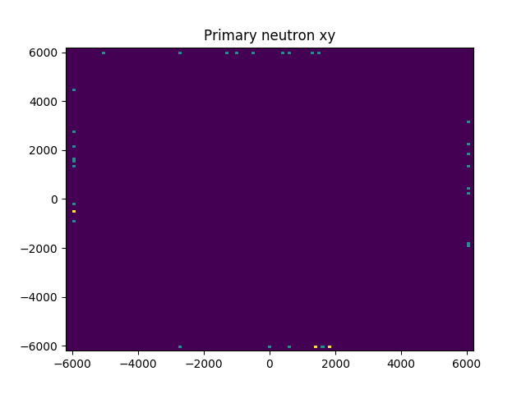
Cryoskin n point of emanation which give bkgd
The xz, yz plots are wrong: axes are flipped. I learn after meeting
I need to imshow plot the transpose of histo2d.

Slide 18
(post)Meeting , 19-Feb-2019
Chris wonders why our fidv doesn’t have walls equal distance away on all sides
Eric can run this long, skinny geometry
Richard will get LZ paper to show neutron rate from its SiPMs
No one is sure why the xy,yz,xz histo2Ds are inconsistent.
Fixed a weirdness of matplotlib’s imshow, which requires plotting the histo2D transpose.
Conclusion: indeed no evts come from endcaps. Everything comes from the x,y walls around the fv.

Slide 19
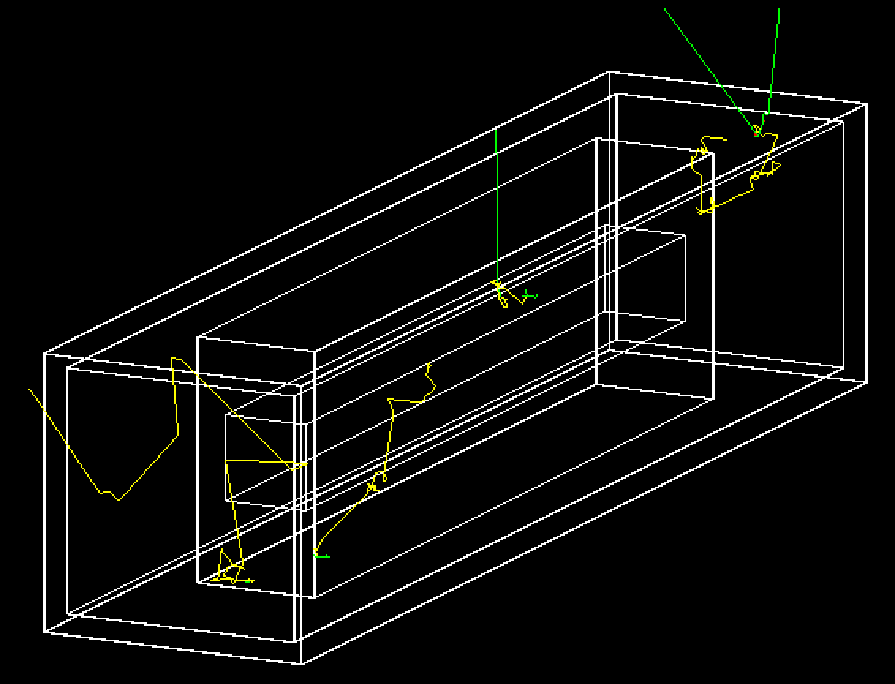
New long-skinny geometry: 4.2x4.2x40 m^3

Slide 20
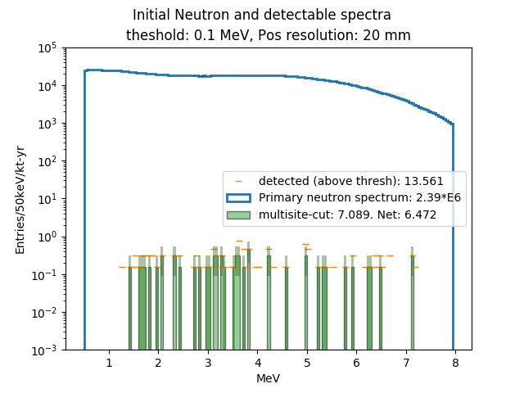
Long skinny fidv has a marginally smaller n count from cold cryo skin.
Compare to upper left, slide 16.
Post-tag: 6.47 vs 7.85
(Each evt has a weight of about 0.4, so raw pre-tag numbers 13.561/0.4 and 13.71/0.4, have stat errors well within 1 sigma of each other.)

Slide 21
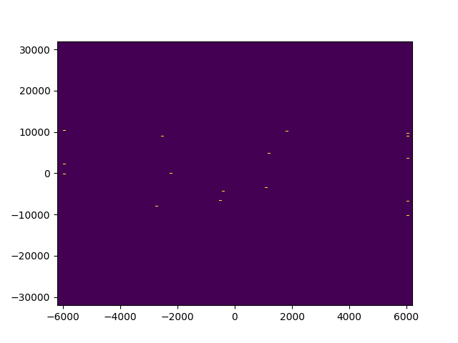
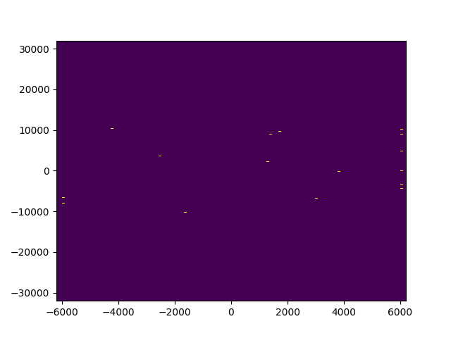
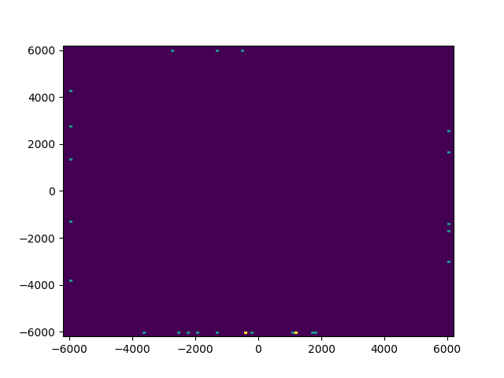
Fixed histo2d’s of location of n’s cryoskin point of origin, which produce the bkgd events in fidv
zx
zy
xy

Slide 22
3-Mar-2020 Meeting
Checks against Darkside20k from RS’s tables
Post-mtg emails: we see consistency achieved
Their n’s are 2-4 orders of mag smaller than my 20E-10 n/cm3/sec
They have 40x less steel
Yet they only have 2400 emanating in 1 kt-yr
I have ~3E6
So they must use 1E-10 n/cm3/sec for consistency, not smaller.
Discussion of late time from large volume reflections and compromising F90
Chris will consider putting it in … somehow
Gabe will talk to me about producing a DUNE DP-ish drawing

Slide 23
13-Mar-2020 – “last mtg”
DUNE Drawing – Gabe 3 hrs
Go to long, skinny, add fidV, more I-beams/water, just one pic, 24x24cm2 tiles, more back walls, different colors,
New n spectrum from Chris Neut-bot or Vitaly – Eric 2 hrs
No n-plot, but long MC run n count vs thickness. baseline is DS20k n SS rate
General editing: Radon discussion, DUNE agnostic language – Chris J 2 hrs
Optical MC explanation, consistency with Richard’s PSD – Chris J 2 hrs
PSD optical sim words and plot – done
Complete Background table – Richard/Chris. 2 hrs + 2 hrs
Particular connection to Darkside20k reference
Sensitivities at agreed-upon bkgds/thresholds – Eric 2 hrs
Meeting today 4 hrs
Ben Loer Reading 2 hrs.
Whence, to DUNE paper committee as advance notice.
Submission arXiv/JINST,EPJC by ~27-Mar – Eric 3 hrs

Slide 24
28-Mar discussion
Recap of Krudyatsev’s paper as on Richard’s slides:
U/Th, 2.8,0.8 mBq/kg in DS20k
1.5/0.8 mBq/kg for LZ
3320/80 mBq/kg DUNE
Eric has used DUNE U/144 so far
Eric will now use 2:1 ratio.
Eric will scan the two spectra and add them 2:1 and run
Eric will make a x:y colz for mid-slice in z and superpose the rectangle that is the fidvolume
Richard will read over text
Shoot for draft to Ben L next wk.

Slide 25
1-Apr discussion: ToDo tasks
Richard 6hrs
neutrino bkgd from DS20
Remove DUNE internal statements about gammas. Make more generic
Use Chris’s alpha-n in Argon info from email
Specify Rn level to get to sub-1 n in bulk
Reorder sentence about 20cm of water from Beacom
Chris 6hrs
Read through
Remove DUNE-specific SN stuff and
remove the Optical Flash figure and text referring to it
Results section
Finish photon sim text
Look for SiPM size consistency 12cmx12cm in text
Eric 4hrs
G4 section – make orderly
Add “Henning’s” UAr sentences
n section
Remake the Th, U, Th+U plot to have all components
State U, Th activities in mBq/kg, relating my 2E-9/cm3/sec and relation to LZ and DS20k
Run n ana job at 75 keV, check remaining scatters in fidv
Sensitivity Plot: 4 plots
100 keV: 1bkgd
10
100
75 keV: 10 bkgd

Slide 26
10-April: release on 15-Apr to Ben/Henning?
Eric
Richard’s new language of gammas needs me to insert a couple things
Straighten out the language on n normalization – currently I have wrong n/cm3/sec from LZ and DS20k
Put 75, 1 bkd on plot w a legend and new line types, 4 plots
Richard
Finish alpha,n stuff. Almost done
Neutrino bkgd calculation, few sentences
Acknowledgment for Shawn
Chris
Reading
Still has to yank DUNE things

Slide 27
15-Apr
Chris
Will finish reading 2nd half by 16-Apr, 5pm PDT
Richard
Will clean up table
Fix up references
Eric
Shrink y scale on Sens plot
Rock neutrons for [50] 75 (100) keV for 3 kt-yrs: 13, 1.6, 0.1
40cm water now!, not 20.
SS neutron for 50 keV

Slide 28
20-Apr-2020
Eric
Sens plot, shades of gray
50 keV in table
Ben: language for code
Chris
Discussion and Results
Llewyn & Smith
Richard
PSD changing w photo coverage and simulation at 50 keV
Text for PSD
Rn numbers

Slide 29
1-May
Abstract sent to DUNE
“Assurance” from Roxanne G on DUNE APB that it’ll fly
Draft sent to Mary for DC
Need to accommodate Richard’s red comments
Need to accommodate Ben’s edits
Henning’s too, if we get ‘em.
Into IR, attach proper draft, wait…
To arXiv (Mon night - Tues) max impact soon after 14:00 Fridays as possible
Send a draft to Pordes, Galibiati, MacDonald
Notice to ANL’s Maury Goodman LBL news
To JINST

Slide 30
May 1, continued
ChrisJ -- LZ and Xenon1T(latest) and XenonNT, PandaX
SiPM tile reference
Pg9 photon tracking
Eric – bibl, titles italicized, journals not, B Loer’s github, not thesis
Fix pg7-8 /s/cm3
Sec 4 add Ben’s 4 (with rho) parameters compared to Lewyn-Smith
Richard
Pg11, 1 msec livetime issue addressed by insisting only on n.r. evts
Pg 14 Pb210 plate-out leading to C13 in acrylic
End of Optical Sim about S1&S2 add 2nd reminder about optical separation

Slide 31
May 5, 2020
Done:
Items on Prev pg
Last paragraph of Discusion/Results section changed
LZ sensitivity included and hopefully cleaner money plot
Needs to be Xenon-NT + LZ
Henning’s comments incorporated – if we agree
Less UAr comment, dates of data-taking for DUNE, DS20k
DUNE APB comments addressed, DUNE->DUNE-like
Mary calls the draft UNCLASS
To Do
Sens plot – today?, Richard interior UAr, Chris DUNE discl…
tag Release on Overleaf
To InfoRelease
Reread by cob, wed
Draft to Jones
arXiv
Send arXiv link to Galbiati/MacDonald/Pordes?
Maury Goodman
JINST

Slide 32
May 8
Richard modifies n 2-site description to be 1 S1s and 2 S2s in response to Ben J’s question. Softens language on obtainability of UAr, per Henning
Eric fixes bibliography ordering, inserts Bryan’s mostly spelling/grammar edits, fixes the sensitivity plot to remove “LIMIT” from “Darkside50-LIMIT”. We decide to leave in the “prepared for JINST”
Chris J needs to re-run the toy light sim with appropriate parameters on new fid v, since he had been using the old fid v. First pass suggests he has to allow more reflections
Else, everyone signs off
Chris will fwd the arXiv link, per Henning, to Art,Cristiano,Stephen

Slide 33
10-May, 6-June
Chris fixes his light yield plot
Photons detected / keV vs fractional coverage
Paper to arXiv at ~7pm PDT, 10-May
:Published to arXiv on 11-May
https://arxiv.org/abs/2005.04824
Sent to JINST on 11-May
Referee report received on 6-June. See next few slides.
In the code repo, along with this document ()

Slide 34
12-June key JINST referee comments
Using UAr in the fourth DUNE module is an idea that has been floating around the community for some time (see for example Kate Scholberg’s contribution to ["The Low-Radioactivity Underground Argon Workshop: A workshop synopsis", arXiv:1901.10108], which should be cited here). Nevertheless, to this reviewer’s knowledge this is the first time the possibility is explored formally with a detector design study.
Richard

Slide 35
The proposal presented in this manuscript is well-researched and well-written. Some design elements could be better supported by more detailed background estimate studies, although this could come later in a future Technical Design Report. In particular, it is unclear whether some of the chosen shielding thickness values are in fact optimal (3.5 m of UAr outside the fiducial region on all sides, 5 cm acrylic walls), so the 1 kT fiducial mass sounds arbitrary. Could it be made larger in the transverse dimension? Part of this answer is provided in Figure 3 on the dominant reducible neutron backgrounds: it would be best to show how, based on this simulation, the dark matter sensitivity (based on total background estimates at a given threshold) depends on the transverse dimension of the fiducial region.
1.) Eric: #n,m vs xy square, keeping z as is 2. #n,m keep transverse 4.2, vs z
See slide 42-44

Slide 36
The photon counting study seems sound to first order, given the assumptions stated. Attenuation in argon is explicitly neglected on page 9, however for a detector of this size the effect may actually be significant: for example [Neumeier, A. et al. EPJC 72, 2190 (2012)] measured an effective attenuation length on the order of 1.6 m. It would be worth quantifying the impact of this effect on the ability to reach the required PE yield at the photodetectors.
Chris: statement + perhaps run with a finite attn length
Eric: look for lambda in fcl file for LArSoft (slide 41)
Richard: will look for another reference on this Royal-Hollaway group

Slide 37
Expected background studies are thorough for some sources, namely radiogenic neutrons, as well as beta and gamma rays, and the irreducible neutrino background. They are however incomplete or absent for other sources, e.g. - Cherenkov backgrounds are very briefly mentioned on page 11 as neglected. They could be a very significant source of high-f90, low-PE background for a detector with this technology and size, and deserve further study. - Alpha decays with unusual topologies, either with limited path length in LAr leading to smaller energy depositions, or with light-shadowing effects, can provide significant backgrounds that are not considered here. Without necessarily going into much detail, they would be important to mention too
Chris: clarify sentence about Ckv not being an issue for our geometry. Foils on acrylic, not TPB on acrylic. Comment on reconstructable wall alpha location

Slide 38
Minor text revision requests
Minor text revisions are also recommended, as follows.
Throughout "Darkside" –>"DarkSide" including on Figure 6 page 2 "DP phase" –>"DP" as P stands for phase
page 4 "The motivation of the size of the inner volume is largely cost-based": this may be true for directions along the photodetector plane, but not perpendicular to it?
page 5 "Darkside50" –>"DarkSide-50" with dash
page 6 7.3*10ˆ-4 Bq/kg * 4.3*10ˆ6 kg = 3.1 kBq, suggesting to write this number explicitly
"12 events" pileup over which period of time? [Richard]
page 8 Figure 2 x-axis quantity missing "neutron energy [MeV]"
page 14 Footnote: please write km/sec unit after each speed value
page 15 Figure 6: DEAP-3600 curve does seem to reflect their latest results, although the correct reference is [DEAP Collaboration, Search for dark matter with a 231-day exposure of liquid argon using DEAP-3600 at SNOLAB. Physical Review D, 100 (2019) 022004]: please add in caption and References section. Reference missing in Figure 6 caption for XENONnT expected sensitivity. Figure 6 title and caption: after "90%" add "C.L." Figure 6 y-axis would be clearer as "Spin-independent WIMP nucleon cross section [cmˆ2]" Figure 6 x-axis unit should be [TeV/cˆ2]
Richard says there’s a DARWIN paper that gives a citation.

Slide 39
page 16 The clarity of Table 1 would be greatly improved with three distinct columns for the three threshold scenarios (100 keVr, 75 keVr, 50 keVr). A row with "total" background estimates would be nice to have as well. "bPSD" and "aPSD" acronyms are unnecessary, please spell out "before PSD" and "after PSD". If necessary, making the table orientation landscape would give more space to implement these suggestions.
Richard

Slide 40
References For consistency, please cite as collaboration names where appropriate, i.e. Ref 4: DarkSide-50 Collaboration Ref 15: DarkSide-50 Collaboration Ref 16: DEAP Collaboration
SNO and LuxZep too
Eric (done, 17-June)

Slide 41
19-Jun-2020
Attenuation length
VUV https://www.sciencedirect.com/science/article/pii/S0927650516302341?via%3Dihub
Suggests 5m at 1ppb, which uB has achieved (https://microboone.fnal.gov/wp-content/uploads/MICROBOONE-NOTE-1003-PUB.pdf)
LArSoft defaults
https://github.com/LArSoft/lardataalg/blob/develop/lardataalg/DetectorInfo/larproperties.fcl
 | # absorption length as function of energy -- [cm] confirmed, EC, 19-June
 | AbsLengthEnergies: [ 4, 5, 6, 7, 8, 9, 10, 11 ]
 | AbsLengthSpectrum: [ 2000., 2000., 2000., 2000., 2000., 2000., 2000., 2000.]
 | # Rayleigh scattering length (cm) @ 90K as a function of energy (eV) from arXiv:2002.09346
 | RayleighEnergies: [ 1.18626, 1.68626, 2.18626, 2.68626, 3.18626, 3.68626, 4.18626, 4.68626, 5.18626, 5.68626, 6.18626, 6.68626, 7.18626, 7.68626, 8.18626, 8.68626, 9.18626, 9.68626, 10.1863, 10.6863, 11.1863 ]
 | RayleighSpectrum: [ 1200800, 390747, 128633, 54969.1, 27191.8, 14853.7, 8716.9, 5397.42, 3481.37, 2316.51, 1577.63, 1092.02, 763.045, 534.232, 371.335, 252.942, 165.38, 99.9003, 51.2653, 17.495, 0.964341 ]

Slide 42
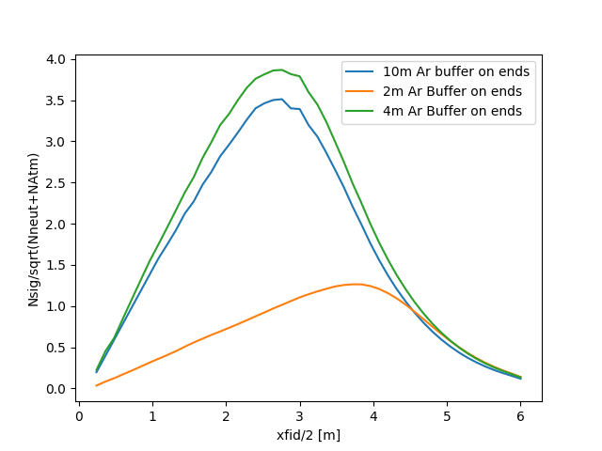
19-June-2020, Fiducial Optimum. For 3 z choices.
Optimal x [m] (FidV [kT]) for z=40,52,56: 2.64 (1.5611904), 2.64 (2.02954752), 3.6 (4.064255999999999)
Signal/neutrons/Atm: 17.30/8.33/15.96,
22.49/13.10/20.75,
45.05/1229.22/41.55,

Slide 43
19-June with optima 1,2
Green and blue for 100 keV
Correspond to
Green/blue prev slide 1.56, 2.03 kT*3 yrs.

Slide 44
19-June
Proposed response to referee
We agree that 3 kT-years is a bit arbitrary. A fiducial 1kt was chosen given a cursory look at neutron backgrounds with strong self-shielding and in order to produce a result in a competitive timescale. Given the comment, we have conducted transverse variations for three choices of fiducial length [in z] – 40m, as proposed in the text, and for 52 m and 56 m. These are 10m, 4m and 2m to nearest end wall, respectively. We consider expected Dark Matter signal size at a cross section choice of 1E-45 cm^2 and 0.2 TeV/c2, and atmospheric neutrino and neutron backgrounds with an assumed 1 gamma event leakage and a threshold of 100 keV. We plot the figure of merit nsig/sqrt(nbkd) vs. x. We find for a 40m length our transverse optimum (half-size) is at 2.64m --a little farther out than our chosen 2.1 m – giving a 1.56 kT fiducial volume. Both these rough f.o.m.’s are slightly higher than our choice of 2.1m. For a 52m length fiducial volume the optimum is also at 2.64m for a 2.03 kT fiducial volume. At 56m the preferred size is far larger at 4m transverse for a far inferior f.o.m. We make the sensitivity plots for the first two new fiducial volumes. The resulting 90% sensitivities are just outside the line width from the figure we have in the paper. We therefore, add a line to the paper that says:
“The optimum fiducial geometry that maximizes signal to external backgrounds was found to be 2.6m for 2.03 kT. We use a conservative 1 kt fiducial volume of the dimensions described after performing a study for a 100 keV threshold that determined that this is very close to the self-shielding optimum geometry, considering expected neutron and atmospheric backgrounds.”

